Slide 1


INTRODUCTION TO LINUX HARDENING
(K)aranbir and Dennis

Slide 2


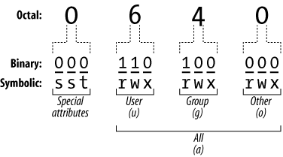
Permissions
Chmod- Change mode. Basically, modify who can do what to files.
> sudo chmod 644 [a file]
Chown- Change ownership
> chown [user:group] [file]

Slide 3
Users
Checking groups
Wheel is an example of an admin group on CentOS and some other linux distributions. The group is sometimes called sudo or sudoers.
Passwd: primary user group
Group: shows users in each group

Slide 4
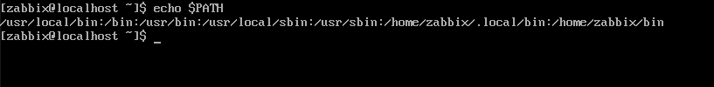
The Path
> echo $PATH
The PATH variable is where bash will look for executables to run
If you want to run your own script, put ./ before it
Separated by ':'

Slide 5
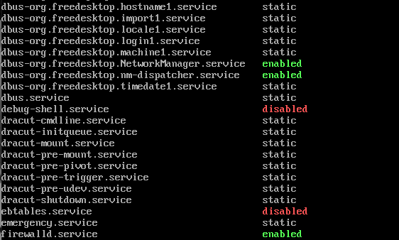
Services
> service --status-all
> systemctl list-unit-files
> sudo netstat -tulpn

Slide 6
Crontab
File that is read to execute automated tasks
Basically a chore list
For backups, updates, etc.
> crontab –e
The –e means "edit" the cron file

Slide 9

GET HELP

Slide 10
The Filesystem
/bin
/boot
/home
/mnt
/sbin
/
/dev
/etc
/lib
/var
/tmp

Slide 11
Navigation Review
cd: go into your directory(folder) of choice
ls: show what’s in the directory
ls -l: ls with the ‘l’ or long option. Shows more info!
ls -la: do not ignore entries. Shows ALL info!
pwd: print working directory. Aka where the heck am I.

Slide 12
Basic I/O Redirection
The PIPE :
ls | grep “findThis”
Take all the ls output and search through it
These things > >> < << (Angle brackets for the intellectuals)
Take all this > and fill a file up with it (replaces file content)
Take all this >> and add it to the end of a file

Slide 13
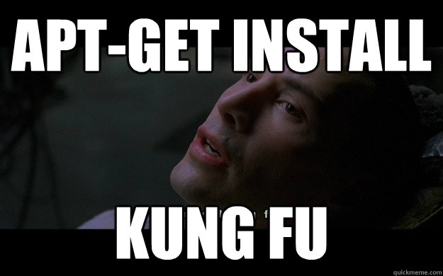
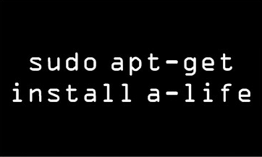
Package Managers
apt-get
Install (install)
Remove (rm)
apt-cache
Search, Show

Slide 14
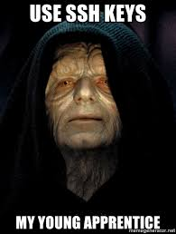
Openssh >_
Remote management of your server! (Port 22)
Copy and paste from your local gui
SECURE. Not Telnet (port 23)
Private key encryption
Symmetric vs Asymmetric

Slide 15

Managing Services
Service or Systemctl???
service - It’s a wrapper.
--status-all
systemctl - Utility that manages running services (background apps. Aka daemons) list-unit-files
SysV - The old way of doing things. AT&T

Slide 16
Working with Files
Cat, Less - Show file contents
Cp, mv, rm - Manage files
Touch - Create blank file
Vim - Text editor. Modify/create files

Slide 17
System Variables
They just store data that the system or programs will read from later
PS1=‘\u@\h@:\w\$ ’
PATH
The echo command.

Slide 18
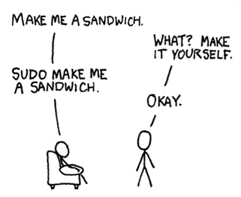

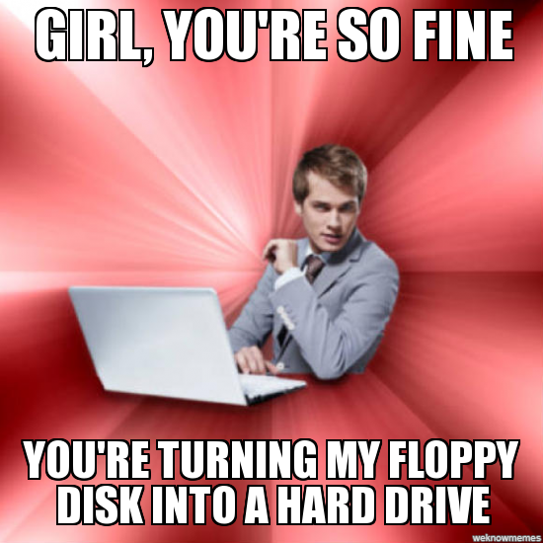

Thank you!
https://da.gd/linux2

